Slide 1
Accrual Accounting in Alma
Yoel Kortick
Senior Librarian

Slide 2

Agenda
What is Accrual Accounting?
An Example of When Accrual Accounting May Be Needed
Enable Accrual Accounting
A Live Example Using Accrual Accounting

Slide 3
What is Accrual Accounting?

Slide 4
What is Accrual Accounting?
In Accrual Accounting expenses are recorded at the time in which the transaction occurs rather than when payment is made
It allows for current cash inflows/outflows to be combined with future expected cash inflows/outflows
http://www.investopedia.com/terms/a/accrualaccounting.asp

Slide 5
What is Accrual Accounting?
In Alma this means that if the institution uses accrual accounting it may accumulate expenditures across multiple fiscal years.
  Accrual accounting takes effect only on expenditures, and not on encumbrances.
When accrual accounting is enabled in Alma, invoice amounts are spread out over all active fiscal periods, beginning with the fiscal period in which the ‘Subscription from date’ (of the invoice line) is contained.

Slide 6
What is Accrual Accounting?
When accrual accounting is not enabled in Alma, if an invoice overlaps two different fiscal periods, the entire invoice amount is attributed to the current fiscal period.
In other words: when accrual accounting is not enabled, and an invoice overlaps two different fiscal periods the amount is attributed to the fiscal period of the current calendar date.

Slide 7
An Example of When Accrual Accounting May Be Needed

Slide 8
An Example of When Accrual Accounting May Be Needed
Let’s take the following example where the institution has two active fiscal periods
  2025. The start and end dates for this fiscal year are Jan. 1, 2025 – Dec. 31, 2025.
  2026. The start and end dates for this fiscal year are Jan. 1, 2026 – Dec. 31, 2026.

Slide 9
An Example of When Accrual Accounting May Be Needed
The library orders a journal and receives an invoice of 1000 USD (or other unit of currency such as AUD or EUR)
The invoice covers the journal subscription for the period from June 1, 2025 – May 31, 2026
The Subscription from date and Subscription to date fields will be entered in the invoice line.

Slide 10
An Example of When Accrual Accounting May Be Needed
This means that the invoice is for 12 months and
  7 months of the invoice are in ‘fiscal period 2025 (Jun, Jul, Aug, Sep, Oct, Nov, Dec)
  5 months of the invoice are in ‘fiscal period 2026 (Jan, Feb, Mar, Apr, May)
This means that (approximately)
  59% of the invoice is for fiscal period 2025 (7/12)
  41% of the invoice is for fiscal period 2026 (5/12)

Slide 11
An Example of When Accrual Accounting May Be Needed
If Accrual Mode is not enabled then all of the invoice’s charges, in this case 1000 USD, are attributed to the current fiscal year (fiscal period 2025)
The invoice’s ‘Subscription from date’ is not taken into account.
If Accrual Mode is enabled: The invoice’s charges are distributed proportionally between ‘fiscal period 2025 and fiscal period 2026.
  580 USD of the invoice is for ‘fiscal period 2025’ (58% of the 1000 total)
  420 USD of the invoice is for ‘fiscal period 2026’ (42% of the 1000 total)

Slide 12
An Example of When Accrual Accounting May Be Needed
In this example it is not enough that Accrual Mode is enabled.
There must also be two active fiscal periods.
In this specific example even if accrual Mode is enabled both ‘fiscal period 01/01/2025-31/12/2025’and ‘fiscal period 01/01/2026-31/12/2026’ must be active.
If only ‘fiscal period 01/01/2025-31/12/2025’ were active and Accrual Mode is enabled then all expenditures would be on ‘fiscal period 01/01/2025-31/12/2025’(because ‘fiscal period 01/01/2026-31/12/2026’ is not active).

Slide 13
Enable Accrual Accounting

Slide 14
Enable Accrual Accounting
Three conditions must be true for accrual accounting to work:
Parameter ‘acquisition_accrual_mode’ must be set to true
There must be an active fiscal period in the current year and an active fiscal period for a future period
The fund being used in the future fiscal period must be defined to receive expenditures prior to the start of the fiscal period of the fund

Slide 15

Enable Accrual Accounting
In order to enable accrued accounting, navigate to Acquisitions Configuration menu > General > Other Settings
Change ‘acquisition_accrual_mode’ to true

Slide 16
Enable Accrual Accounting
In addition to defining ‘acquisition_accrual_mode’ to ‘true’, there must be multiple active fiscal periods.
It is also necessary to configure the fund of a fiscal period to accept expenditure transactions prior the start of the fiscal period.
For example, if a fund of fiscal period is not enabled to accept expenditure transactions prior the start of the fiscal period, then even if ‘acquisition_accrual_mode’ is set to true and there are two active fiscal periods the accrual mode will not work

Slide 17
Enable Accrual Accounting
Here for example, we have two active fiscal periods:
FY-2025 with
start date ‘01/01/2025’ and end date ‘31/12/2025’
FY-2026 with
start date ‘01/01/2026’ and end date ‘31/12/2026’

Slide 18
Enable Accrual Accounting
We will now concern ourselves with these two funds:
  Name: Library and Information Science
    Code: LIS
    Type: Allocated fund Status: Active
    Fiscal Period: 01/01/2025 - 31/12/2025
  Name: Library and Information Science
    Code: LIS
    Type: Allocated fund Status: Active
    Fiscal Period: 01/01/2026 - 31/12/2026

Slide 19
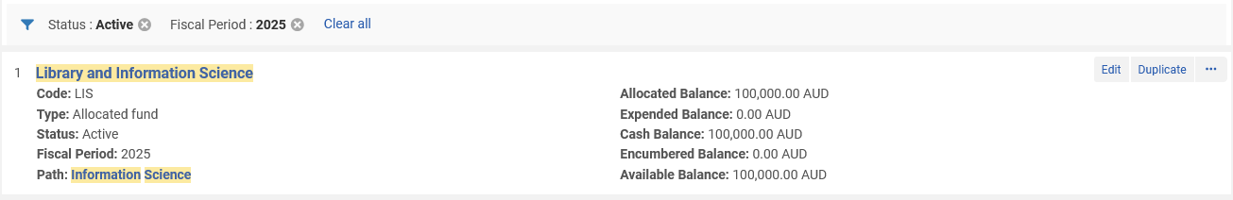
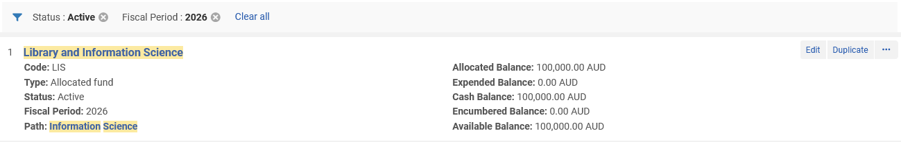
Enable Accrual Accounting
Here are the two allocated funds:

Slide 20
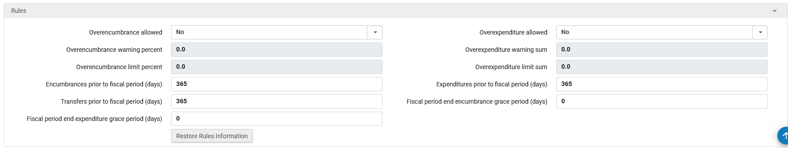
Enable Accrual Accounting
For allocated fund ‘Library and Information Science’ in Fiscal Period 2026 we have defined that it can take expenditures 365 days (a full year) prior to the start of the fiscal period

Slide 21
Enable Accrual Accounting
We also set “Encumbrances Prior to Fiscal Period (Days)” = 365.
Note that the field ‘Encumbrances Prior to Fiscal Period (Days)’ is not specifically related to accrual accounting.
Here the librarian can set a rule in a fund that this fund can receive encumbrance transactions X days before the beginning of its fiscal period.
This means that when the librarian will click on the PO Line fund lookup, he or she will be able to see this fund X days before the fiscal period starts and add it to the PO Line.

Slide 22
A Live Example Using Accrual Accounting

Slide 23
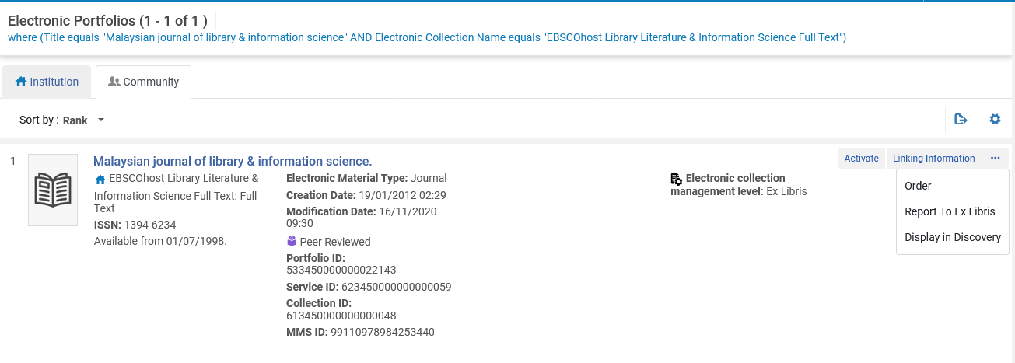
A Live Example Using Accrual Accounting
We will now create a POL for title “Malaysian journal of library & information science”

Slide 24
A Live Example Using Accrual Accounting
The library makes an order (POL-44301) for it for the period of June 1, 2025 – May 31, 2026 for 1000.00 AUD using allocated fund ‘Library and Information Science’ from the fiscal period ‘01/01/2025-31/12/2025’

Slide 25
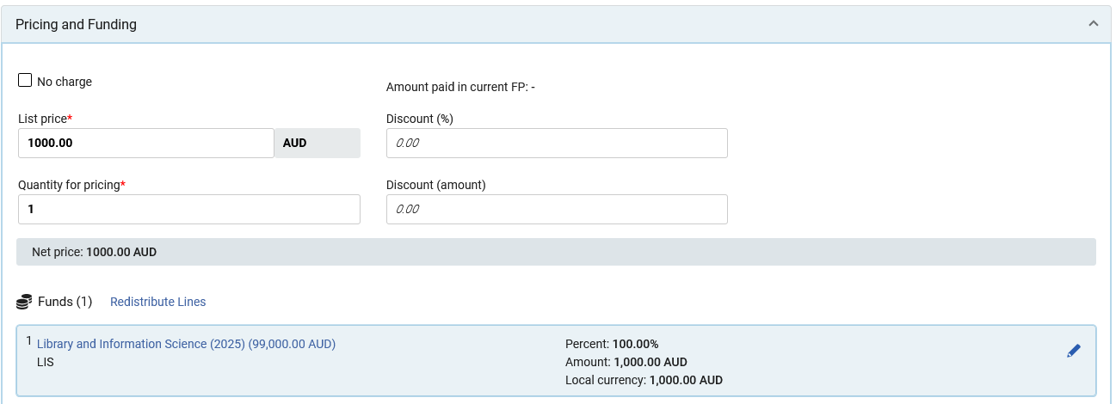
A Live Example Using Accrual Accounting
Here is the price and fund in the order (POL-44301)
Note that the price could be different. For our purposes what matters is the amount that will be on the invoice

Slide 26
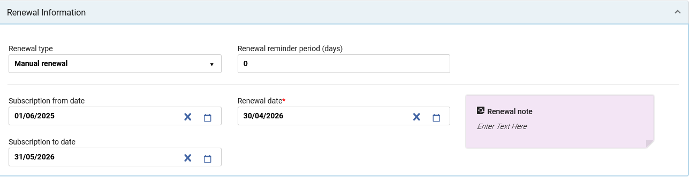
A Live Example Using Accrual Accounting
Here is the subscription period in the order (POL-44301)
Note that the subscription from and to date could be different. For our purposes what matters is the dates that will be on the invoice

Slide 27

A Live Example Using Accrual Accounting
Here is the order (POL-44301)

Slide 28
A Live Example Using Accrual Accounting
At a later stage an invoice arrives for the period of June 1, 2025 – May 31, 2026 for 1000.00 AUD
The staff user adds an invoice line which is the order for the Journal (POL-44301)
‘Accrual Mode’ is checked in the invoice line. This is by default, and we will not change it
Automatically Alma will break down the expenditure from each of the included fiscal years and show the percent of each
(Note that when using accrual accounting and creating an invoice the “create from PO” option cannot be used)

Slide 29
A Live Example Using Accrual Accounting
The next three slides show various parts of the invoice line in depth (for invoice number 202504271916).

Slide 30
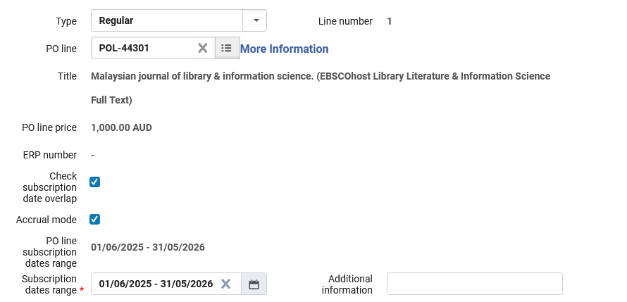
A Live Example Using Accrual Accounting
This is the POL of the journal
Accrual Mode is checked
Subscription dates spanning multiple fiscal periods

Slide 31
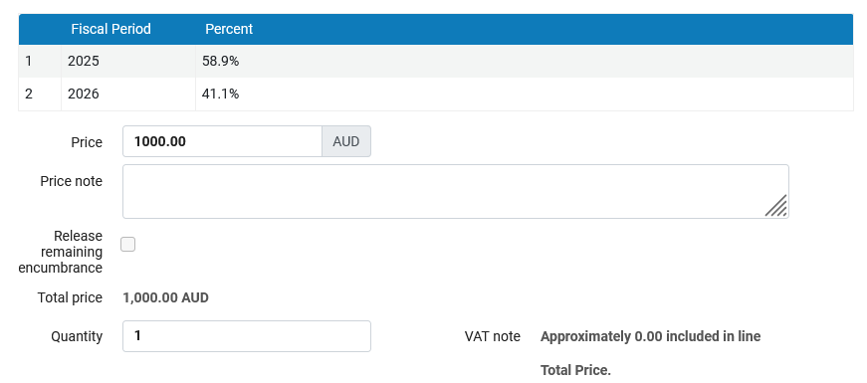
A Live Example Using Accrual Accounting
The 1000.00 AUD will be proportionally split between two fiscal periods

Slide 32
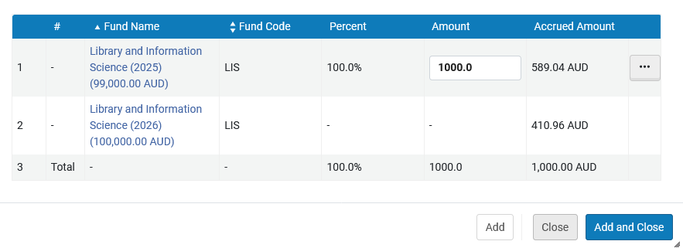
A Live Example Using Accrual Accounting
Alma automatically shows the amount of the payment for each fiscal period (based on percent of time the 1000.00 USD falls into that fiscal period)

Slide 33
A Live Example Using Accrual Accounting
Note that in the invoice line the check box “Accrual Mode” was checked. This will be checked by default when accrual accounting is activated on in the institution level
It is still possible to not use accrual mode on a “one by one” basis on the invoice level even though on the institution level accrual mode is activated. This is done by unchecking the “Accrual Mode” check box.
This might be the case, for example, when the fund in the next Fiscal Period no longer exists or was split. Unchecking the “Accrual Mode” check box will set the calculation to be without accrual accounting and if funds were already added – each fund can then be deleted or edited manually.

Slide 34
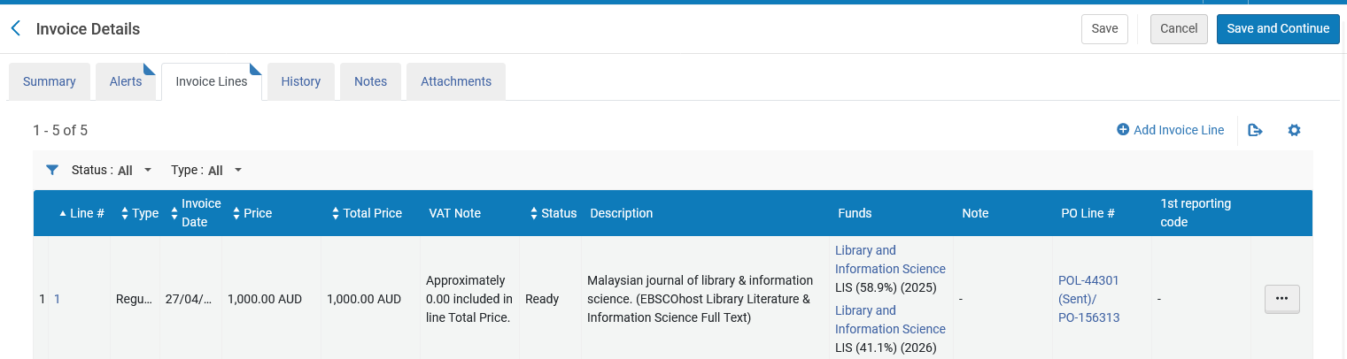
A Live Example Using Accrual Accounting
Here is the invoice line in the invoice line list. We see the breakdown of funds from two different fiscal periods.

Slide 35
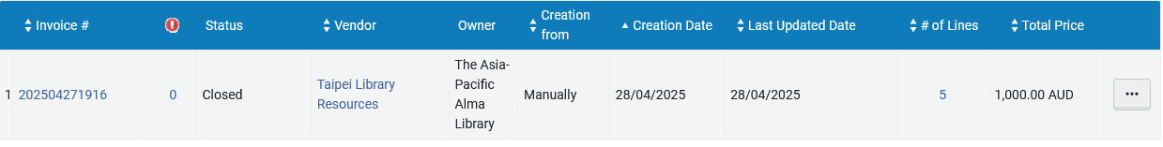
A Live Example Using Accrual Accounting
The invoice is paid and closed

Slide 36
A Live Example Using Accrual Accounting
And if we look at the fund expenditures, we see that:
Even though we are in fiscal period ‘1/1/2025-21/12/2025’ we still have an expenditure for the future active fiscal period
The expenditure appears for both active funds and not only the one which has a date overlapping with the current date.

Slide 37
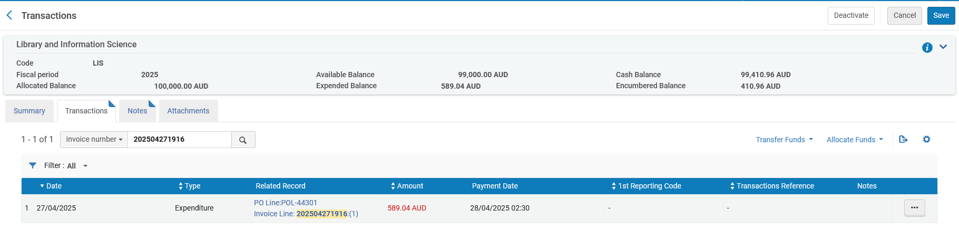
A Live Example Using Accrual Accounting
Here is the expenditure on 2025

Slide 38
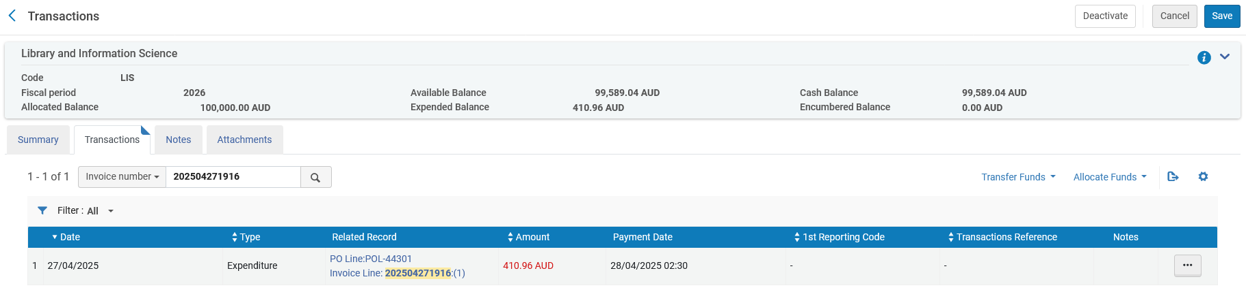
A Live Example Using Accrual Accounting
Here is the expenditure on 2026

Slide 39
A Live Example Using Accrual Accounting
In summary:
We have two open active fiscal periods
We pay for a subscription covering a time period that spans both fiscal periods.
Alma automatically divides the payment among the fiscal periods depending on how much time is in each fiscal period.
Alma includes an expenditure on a future fiscal period and a current fiscal period, both of which are active.

